Slide 1

Introduction to Generative AI (GenAI)

Slide 2
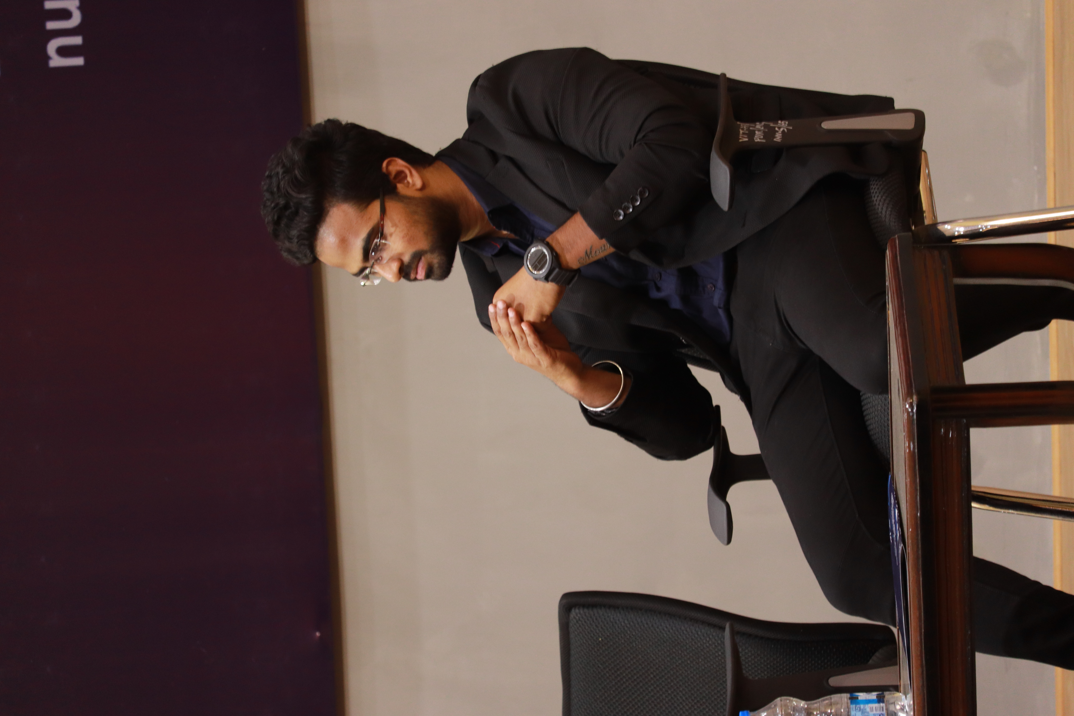

It’s Me !!!!!
JAI GANESH
Senior Ai Architect
Valeo Detection Systems
AI – R & D
SPEAKER OF INDIA BOOK OF RECORD
Jai Ganesh HCL Technologies Senior Lead Engineer R & D - Microsoft

Slide 3
Difference between AI, ML, DL, and GenAI
AI
Machine Learning
Deep Learning
Build an application that can perform its own task without human intervention
Neflix – Recommendation Sys.
Tesla - Self driving car
Ai Engineer – will create and deploy the Ai product.
Machine Learning, a subset of AI that focuses on building algorithms using stat tools that can learn from data and make predictions.
Predictive Analysis
Statistical Model
Forecasting Designs
Understand about the data
Deep Learning, a more advanced ML technique that uses neural networks to analyze complex data and automate decision-making.
ANN & DNN – Array or Dataframe
CNN – Image/Computer vision
RNN – Text related & Time Series

Slide 4

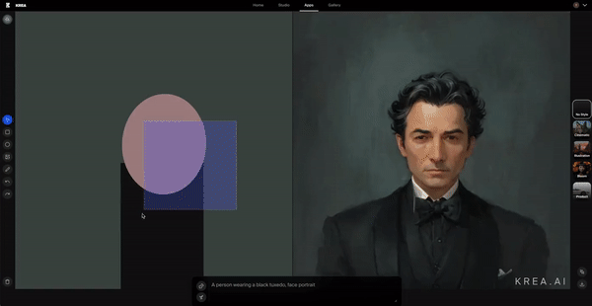
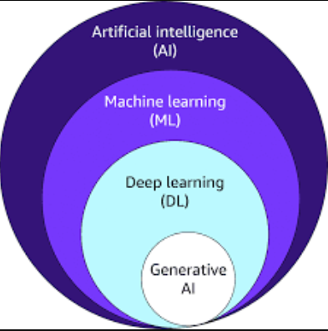
Generative AI
You might heard about “TRANSFORMERS & BERT”
Discriminative Model
1
Task: Classification & Prediction & Analysis
Dataset: Models are trained on labeled dataset
Generative Models
2
Task: Generates the new unique data & trained on huge dataset
Eg. If GenAI model with mountain & ocean – should generate new scenario.
Large Language Models & Large Image Models

Slide 5
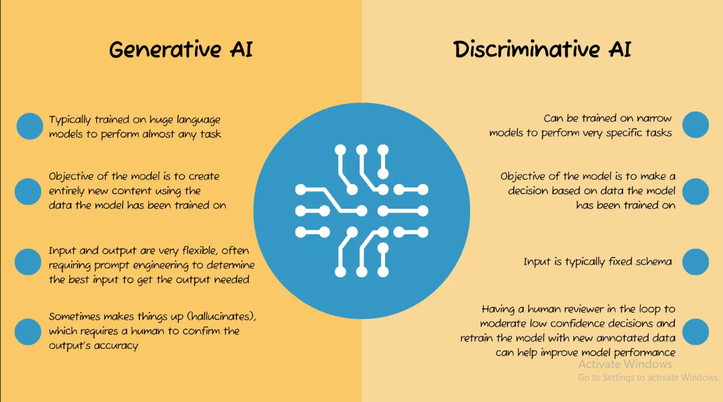
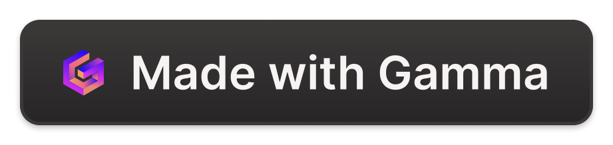
Difference between AI, ML, DL, and GenAI
AI
ML
DL
The broad field of Artificial Intelligence, which aims to create machines that can perform human-like tasks.
Recommendation Models
Autonomous Vehicle
Any AI Products
Machine Learning, a subset of AI that focuses on building algorithms that can learn from data and make predictions.
Predictive Analysis
Statistical Model
Forecasting Designs
Deep Learning, a more advanced ML technique that uses neural networks to analyze complex data and automate decision-making.
ANN & DNN – Array or Dataframe
CNN – Image
RNN – Text related & Time Series

Slide 6

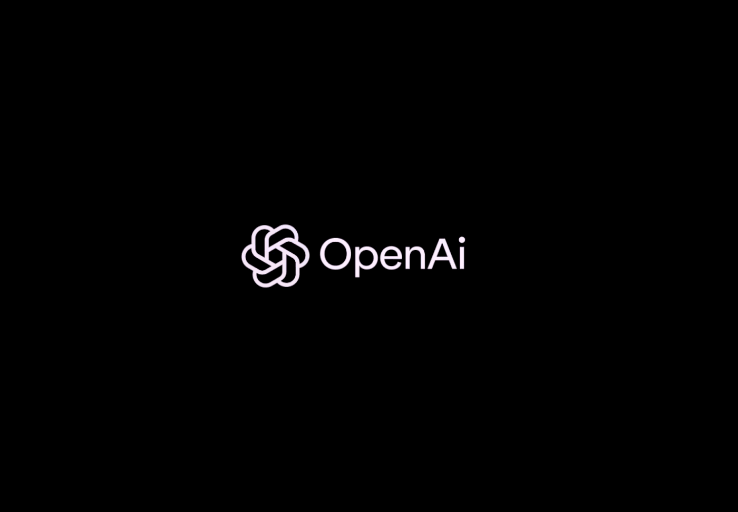
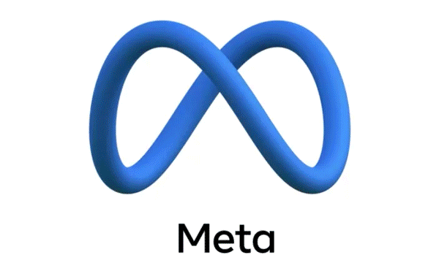

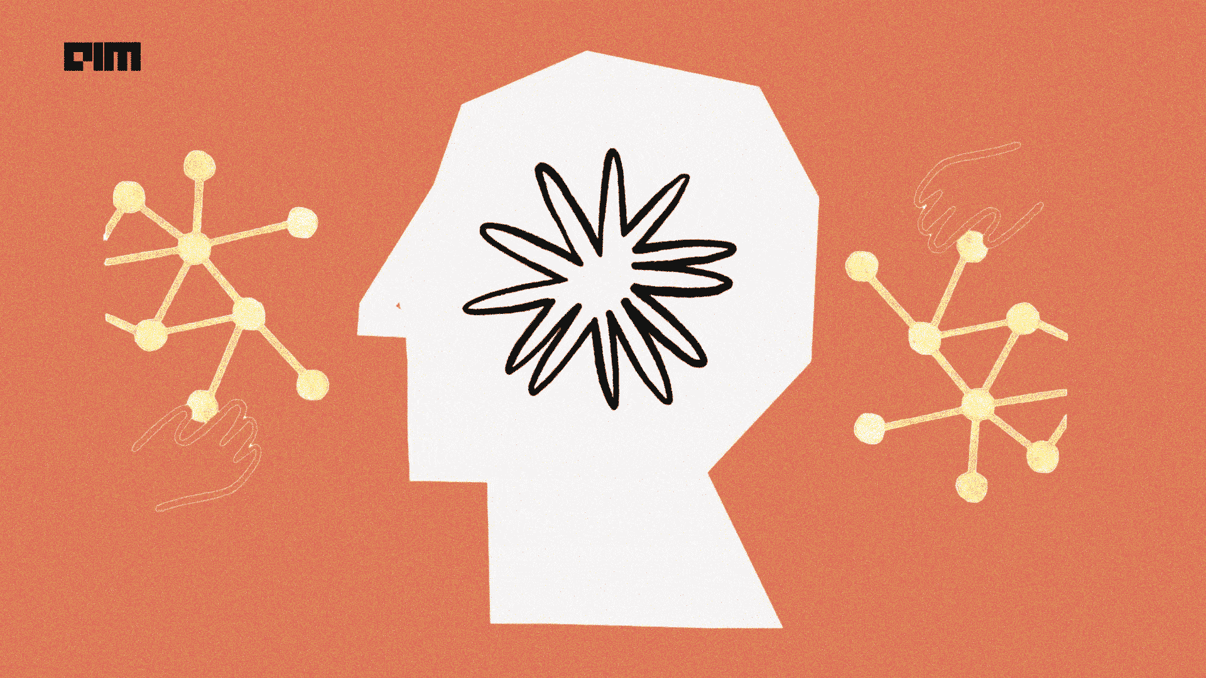
To Know More about LLM…
1
Open AI – GPT4
Generative Pre-trained Transformer 4 is a multimodal large language model created by OpenAI. GPT 3.5 – 175 Billion parameter & GPT-4 – 1 Trillion
2
Meta – LLAMA 2
Llama is a family of autoregressive large language models released by Meta AI starting in February 2023. Now, it’s trained with 65 Billion parameter
3
Google - Gemini
Google Gemini is a family of multimodal LLM developed by Google DeepMind, serving as the successor to LaMDA and PaLM 2. LaMDA – 137 Billion parameters
4
Anthropic - Claude 3
The Claude LLM focuses on constitutional AI, which shapes AI outputs guided by a set of principles that help the AI assistant it powers helpful. Claude3 – 137 Billion parameters

Slide 7
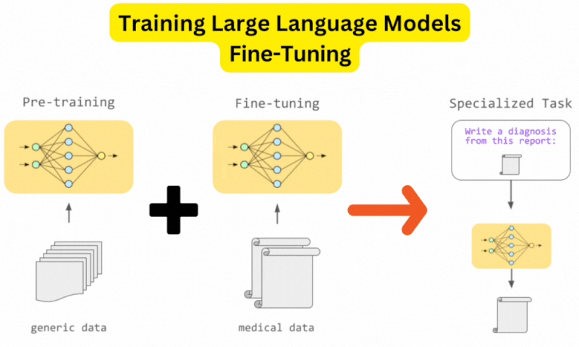
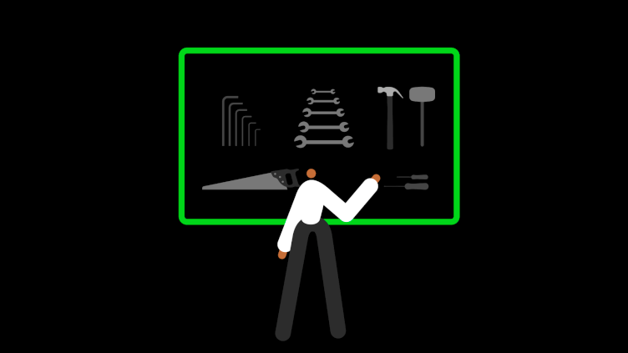
How can we use those LLMs?
Large Data
Foundation Model
Pre-trained Model
Fine Tuning – Domain Specific Model

Slide 8



Here you can start!!!
Generative Adversial Network Architecture
Transformer Architecture – Parallel Computation
Large Language Models – BERT, BART, Distilbert
Generative Pre-Trained Model – GPT Architecture

Slide 9

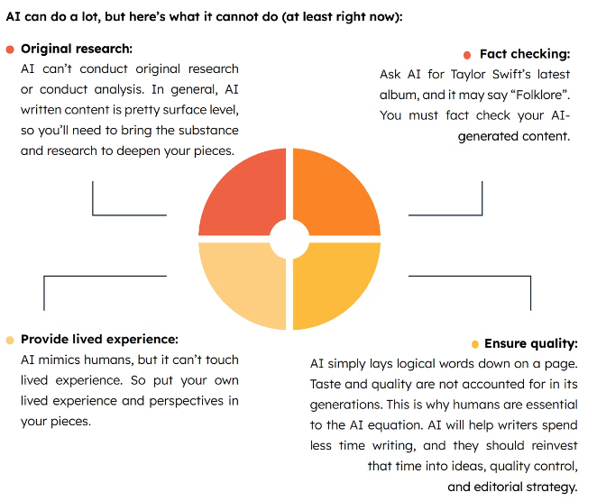
Limitations and Challenges of GenAI
Bias and Accuracy
GenAI models can perpetuate biases and produce inaccurate or unreliable outputs if not trained properly.
Lack of Contextual Understanding
GenAI models may struggle to fully comprehend the nuances and context required for certain tasks.
Computational Intensity
Training and running GenAI models requires significant computational resources and energy consumption.
Ethical Considerations
The use of GenAI raises important ethical questions about privacy, security, and the impact on jobs and society.

